Slide 1
Compiler design 14CS73 Bottom up Parsing
Dr. Saroja Devi H.

Slide 2
Bottom up Parsing
A bottom-up parse corresponds to the construction of a parse tree for an input string beginning at the leaves (the bottom) and working up towards the root (the top).
It is convenient to describe parsing as the process of building parse trees, although a front end may in fact carry out a translation directly without building an explicit tree.

Slide 3
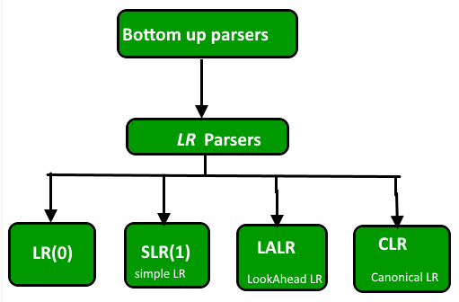
Bottom Up parsing & classification
Build the parse tree from leaves to root. Bottom-up parsing can be defined as an attempt to reduce the input string w to the start symbol of grammar by tracing out the rightmost derivations of w in reverse.

Slide 4
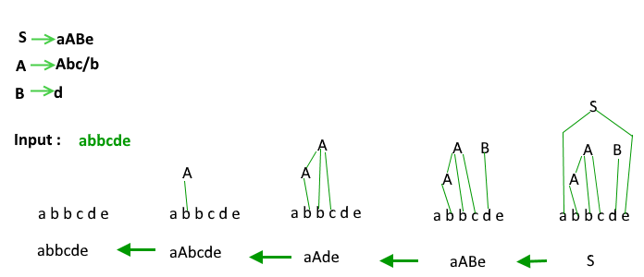
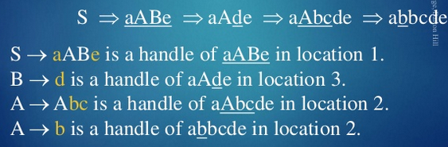
Example
Handle pruning: It is the basis. Finding a handle and reducing it to appropriate left hand side is handle pruning.
Grammar

Slide 5
Shift reduce parser
Shift Reduce parser attempts for the construction of parse in a similar manner as done in bottom up parsing i.e. the parse tree is constructed from leaves(bottom) to the root(up). A more general form of shift reduce parser is LR parser. The L stands for scanning the input from left to right and R stands for constructing a rightmost derivation in reverse.
This parser requires some data structures i.e.
An input buffer for storing the input string.
A stack for storing and accessing the production rules.

Slide 6
Basic operations of Shift reduce parsing
Shift: This involves moving of symbols from input buffer onto the stack.
Reduce: If the handle appears on top of the stack then, its reduction by using appropriate production rule is done i.e. RHS of production rule is popped out of stack and LHS of production rule is pushed onto the stack.
Accept: If only start symbol is present in the stack and the input buffer is empty then, the parsing action is called accept. When accept action is obtained, it means successful parsing is done.
Error: This is the situation in which the parser can neither perform shift action nor reduce action and not even accept action.

Slide 7
Example for shift reduce parsing
Example 1 – Consider the grammar S –> S + S S –> S * S S –> id Perform Shift Reduce parsing for input string “id + id + id”.

Slide 8
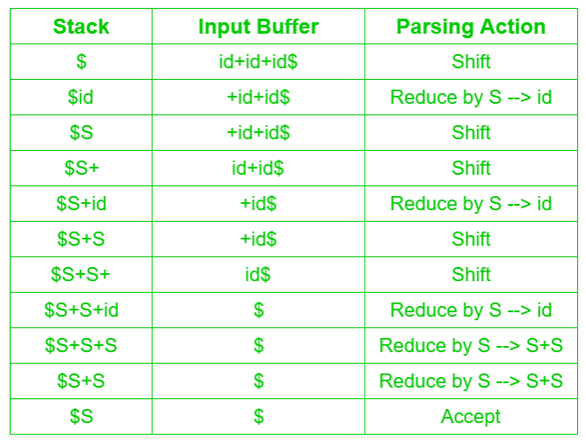
Stack moves
Grammar:
S –> S + S S –> S * S S –> id

Slide 9
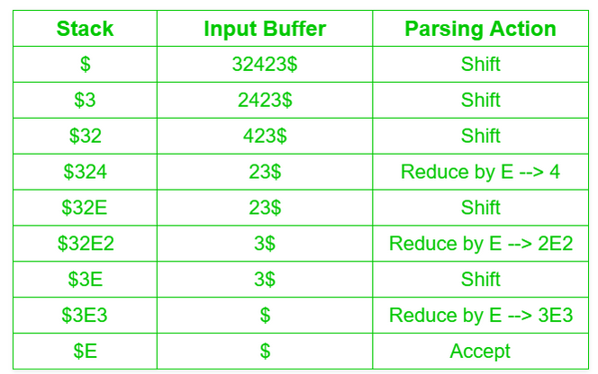
Example2 for shift reduce parsing
Grammar: E –> 2E2 ; E –> 3E3; E –> 4 Perform Shift Reduce parsing for input string “32423”.

Slide 10
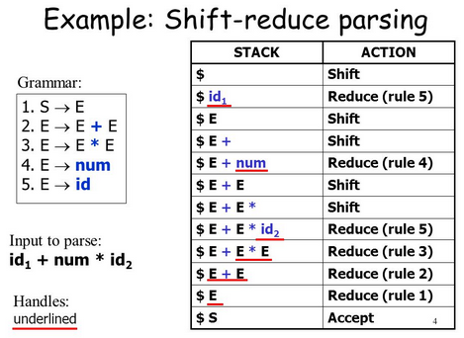
3.
Precedence of * over + is preserved

Slide 11
Try it
Grammar:
S-> 0S1
S->01
reduce 000111 using shift reduce parsing method, showing the stack moves.
reduce 00S11 using shift reduce parsing method, showing the stack moves.

Slide 12
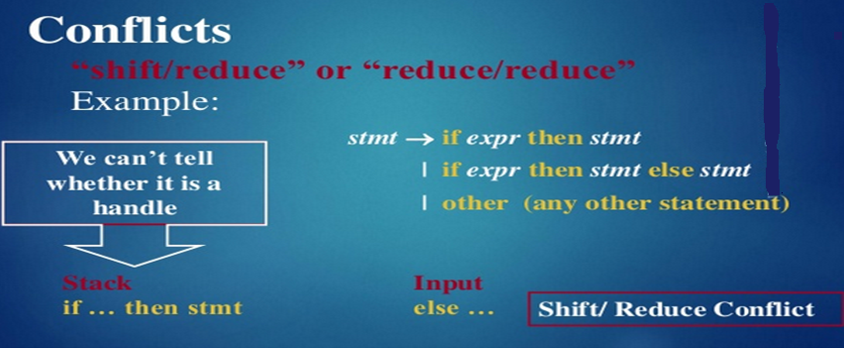
Conflicts during shift reduce parsing
There are two kinds of conflicts that can occur. A shift-reduce conflict occurs in a state that requests both a shift action and a reduce action. A reduce-reduce conflict occurs in a state that requests two or more different reduce actions.

Slide 13
Reduce reduce conflict example
A-> Bcd | Ecf
B->xy
E->xy
For an input string xyc even with look ahead of one character c, it is not possible to decide whether to reduce xy with E or with B.
For an input string, xycd , with look ahead =2, it will be clear that xy must be reduced to B.

Slide 14
Introduction to LR Parsing: Simple LR
Bottom up parser is based on LR(k) parsing, where L indicates left to right scanning of the input and R indicates constructing the rightmost derivation in reverse, and k (default 1) represents the no.of input symbols of lookahead for making parsing decisions. Parser generator like yacc/bison is used for constructing the LR parser
Simple LR (SLR) is a shift reduce parser.
Items and parser states are defined first.

Slide 15
Advantages & disadvantage of LR parsers
Advantages:
LR Parsers can recognize any language for which a context free grammar can be written.
LR Parsing is the most general non-backtracking shift-reduce method known, yet it is as efficient as other shift-reduce methods.
An LR-parser can detect a syntactic error as soon as it is possible to do so on a left-to-right scan of the input.
The class of grammars that can be parsed by an LR parser is a proper superset of the class of grammars that can be parsed by a predictive parser. For a grammar to be LR(k) we must be able to recognize the right side of a production in right sentential form, with k input symbols lookahead. This is less stringent than LL(k) grammar where we must be able to recognize the use of a production. Thus LR grammars can describe more languages than LL grammars.
Disadv.: Too much work to construct LR parser; a specialized tool, LR parser generator like Yacc “Yet Another Compiler-Compiler” is needed.

Slide 16

Canonical collection of LR(0) items
To construct LR(0) item set, we define an augmented grammar and 2 functions, closure() and goto()
An LR (0) item is a production G with dot at some position on the right side of the production.
LR(0) items is useful to indicate that how much of the input has been scanned up to a given point in the process of parsing.
Reduce actions are placed in entire row.
A production A-> XYZ yields the 4 items =>
.X means X initial and X. means X final.

Slide 17
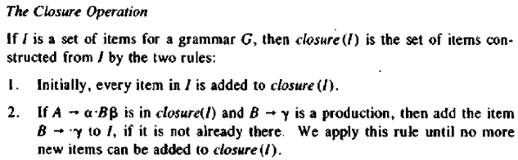
The Closure operations
The Closure algorithm:
SetOfltems closure (I) {
J = I;
repeat
for ( each item A —> α.Bβ in J )
for ( each production B —> γ of G )
if ( B —> .γ is not in J )
add B —> .γ to J;
until no more items are added to J on one round;
return J;
}

Slide 18
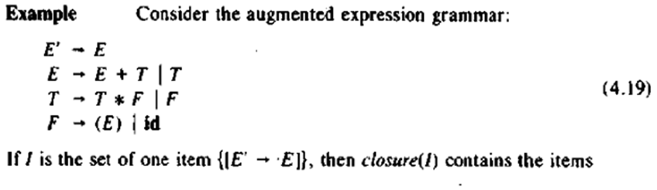
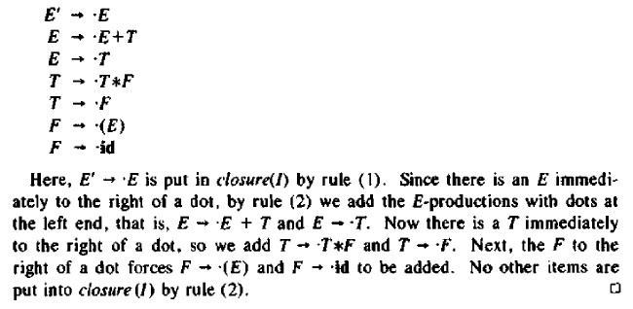
Example for Closure

Slide 19
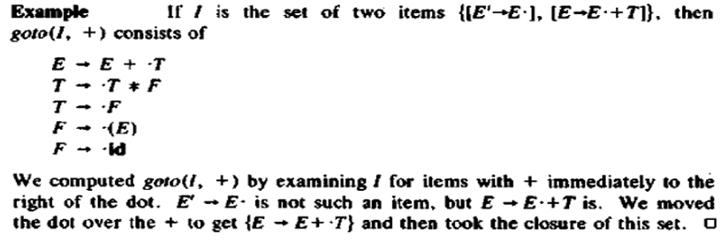
The goto operation
The second useful function is goto(I, X) where I is a set of items and X is a grammar symbol. goto(I , X) is defined to be the closure of the set of all items [A -> αX.β] such that [A -> α • Xβ] is in I. Intuitively, the goto function is used to define the transitions in the LR(0) automaton for a grammar. The states of the automaton correspond to sets of items, and goto(I,X) specifies the transition from the state for I under input X.
Refer to grammar 4.19 for the example below.

Slide 20
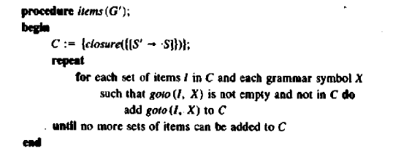
Set of items constructions
Algorithm to construct C, the canonical collection
of sets of LR(0) items for an augmented grammar G‘ is shown below.

Slide 21
Example LR(0)
Given grammar:
S → AA
A → aA | b
Add Augment Production and insert '•' symbol at the first position for every production in G
S` → •S
S → •AA
A → •aA
A → •b
Notes:
Equivalent grammar:
S->CC
C->cC|d

Slide 22
I0 & I1 state
Add Augment production to the I0 State and Compute the Closure
I0 = closure (S` → •S)
Add all productions starting with S in to I0 State because "•" is followed by the nonterminal. So, the I0 State becomes
I0 = S` → •S S → •AA
Add all productions starting with "A" in modified I0 State because "•" is followed by the nonterminal. So, the I0 State becomes now
I0= S` → •S S → •AA A → •aA A → •b
I1= goto(I0, S) = closure (S` → S•) = S` → S•
Here, the Production is reduced, the State is closed and the string is accepted.

Slide 23
I2 & I3
I2= goto(I0, A) = closure (S → A•A)
Add all productions starting with A in to I2 State because "•" is followed by the nonterminal. So, the I2 State becomes
I2 =S→A•A A → •aA A → •b
goto(I2,a) = closure (A → a•A) = (same as I3)
goto(I2, b) = closure (A → b•) = (same as I4)
I3= goto(I0,a) = closure (A → a•A)

Slide 24
I3 to I6
I3: Add productions starting with A in I3. closure(A->a.A)
A → a•A A → •aA A → •b
goto(I3, a) = closure (A → a•A) = (same as I3) goto(I3, b) = closure (A → b•) = (same as I4)
I4= goto(I0, b) = closure (A → b•) = A → b• I5= goto(I2, A) = closure (S → AA•) = SA → A• I6= goto(I3, A) = closure (A → aA•) = A → aA•

Slide 25
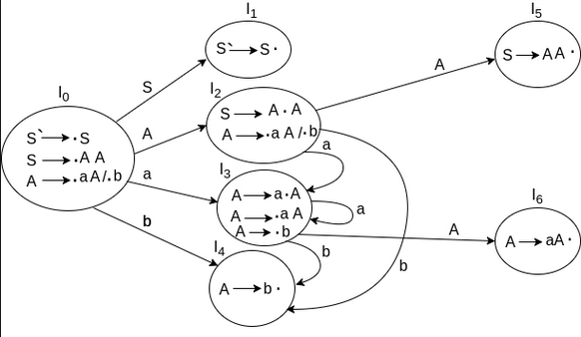
DFA has I0 to I6 (7 states)
Shift, goto or reduce moves; need to consider the FOLLOW sets while reducing.
FOLLOW(A)={a,b,$}
FOLLOW(S)={a,b,$}
$
Accept
Notes:
If a state is going to some other state on a terminal then it correspond to a shift move.
If a state is going to some other state on a variable then it correspond to go to move.
If a state contains the final item in the particular row then write the reduce node completely.

Slide 26
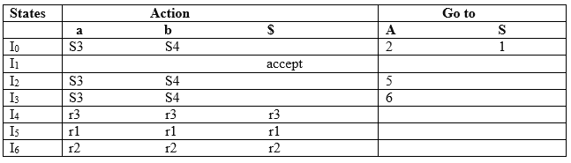
LR(0) table and actions
I0 on S is going to I1 so write it as 1.
I1 on $ results in accept action
I0 on A is going to I2 so write it as 2.
I2 on A is going to I5 so write it as 5.
I3 on A is going to I6 so write it as 6.
I0, I2 and I3 on a are going to I3 so write it as S3 which means that shift 3.
I0, I2 and I3 on b are going to I4 so write it as S4 which means that shift 4.
I4, I5 and I6 all states contains the final item because they contain • in the right most end. So action is reduce with the respective production number.
Numbering productions
1.S → AA
2.A → aA
3.A → b

Slide 27
LR(0) table: Actions (contd..) Follow entries are taken for reducing, so SLR(1)
S → AA ... (1)
A → aA ... (2)
A → b ... (3)
I1 contains the final item which drives(S` → S•), so action {I1, $} = Accept.
I4 contains the final item which drives A → b• and that production corresponds to the production number 3 so write it as r3 in the entire row. Consider FOLLOW(A)={a,b,$} for reducing.
I5 contains the final item which drives S → AA• and that production corresponds to the production number 1 so write it as r1 in the entire row. Consider FOLLOW(S)={a,b,$} for reducing.
I6 contains the final item which drives A → aA• and that production corresponds to the production number 2 so write it as r2 in the entire row. Consider FOLLOW(A)={a,b,$} for reducing.
Numbering production

Slide 28
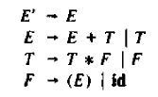
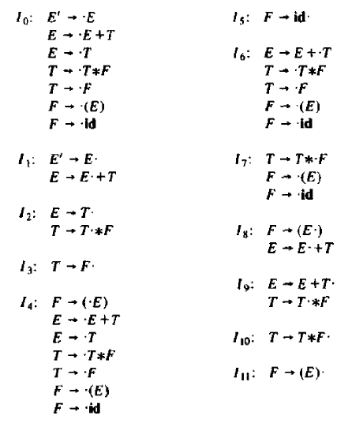
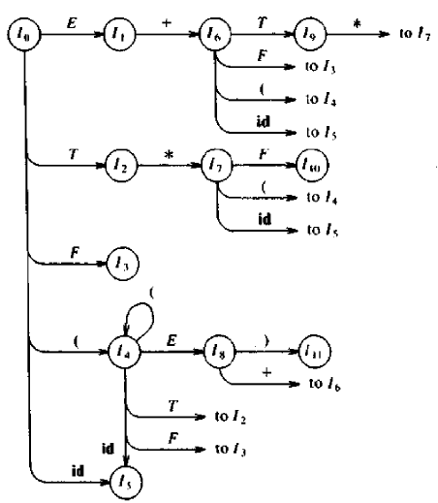
LR(0): diff.example augmented grammar=>
Canonical LR(0) collection
Transition diagram of DFA
$
Accept
Because
Goto(I,X) =
Closure (A->aX.b)

Slide 29
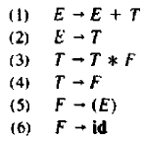
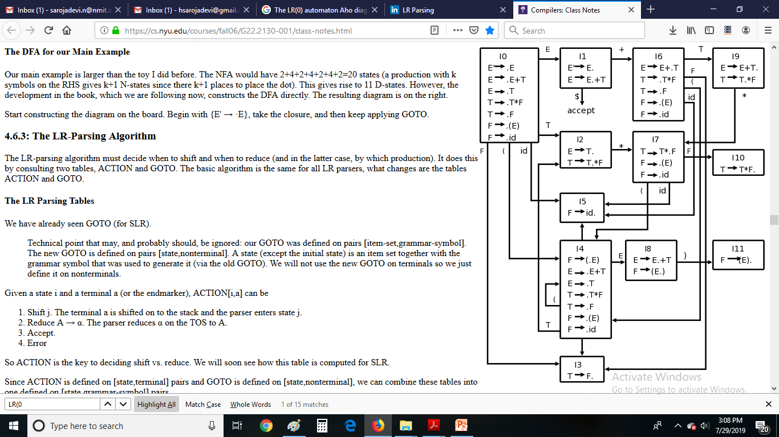
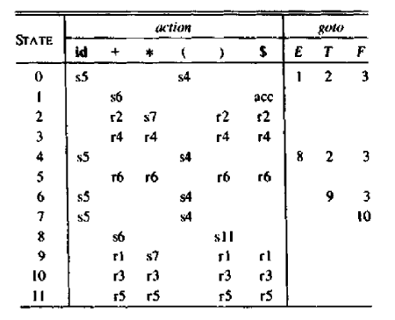
Parsing table for grammar
For states 2&9, consider FOLLOW( E )= {$,+,)} ;
For states 3,10 consider FOLLOW(T)={+,*,),$} in reduce action.
For states 5,11 consider FOLLOW(F) = {+,*,),$} to reduce.
Transition diagram
Parsing table

Slide 30
Structure of the LR Parsing Table
The parsing table consists of two parts: a parsing-action function ACTION and a goto function GOTO.
1. The ACTION function takes as arguments state i and a terminal a (or $, the input endmarker). The value of ACTION[i,a] can have one of four forms:
(a) Shift j, where j is a state. The action taken by the parser effectively
shifts input a to the stack, but uses state j to represent a.
(b) Reduce A->β. The action of the parser effectively reduces β (Beta) on the
top of the stack to head A.
(c) Accept. The parser accepts the input and finishes parsing.
(d) Error. The parser discovers an error in its input and takes some
corrective action.
2. We extend the GOTO function, defined on sets of items, to states: if GOTO[Ii, A] = Ij, then GOTO also maps a state i and a nonterminal A to state j .

Slide 31
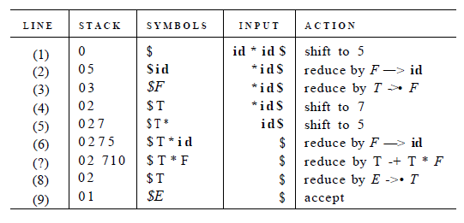
Parse of strings, say id*id using LR(0) DFA
A stack holds states; for clarity, the grammar symbols corresponding to the states on the stack appear in column SYMBOLS. At line (1), the stack holds the start state 0 of the automaton; the corresponding symbol is the bottom-of-stack marker $. The next input symbol is id and state 0 has a transition on id to state 5(shift). At line (2), state 5 (symbol id) has been pushed onto the stack. There is no transition from state 5 on input *, so we reduce. From item [F->id.] in state 5, the reduction is by production F -> id.
With symbols, a reduction is implemented by popping the body of the production from the stack (on line (2), the body is id) and pushing the head of the production (in this case, F). With states, we pop state 5 for symbol id, which brings state 0 to the top and look for a transition on F, the head of the production. From the parsing table, state 0 has a transition on F to state 3, so we push state 3, with F got in.

Slide 32
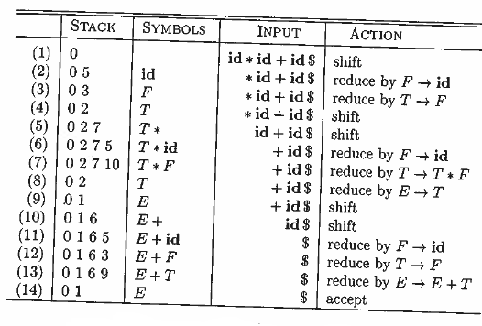
Moves of an LR parser on id * id + id

Slide 33
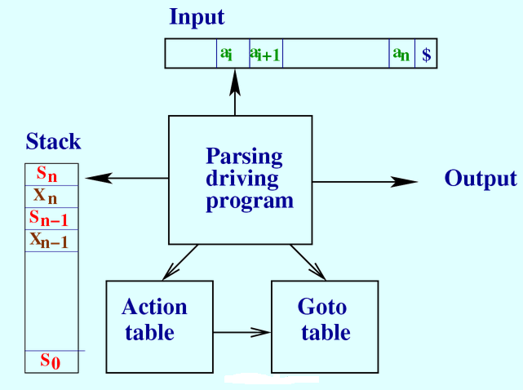
The LR Parsing algorithm Model of an LR Parser
It consists of an input, an output, a stack, a driver program, and a parsing table that has two parts
(ACTION and GOTO). The driver program is the same for all LR parsers;
Only the parsing table changes from one parser to another. The parsing program reads characters from an input buffer one at a time. Where a shift-reduce parser shifts a symbol, an LR parser shifts a state. Each state summarizes the information contained in the stack below it.
Si: state; Xi:grammar symbol;
SiXi:string

Slide 34
LR Parsing Algorithm
INPUT: An input string w and an LR-parsing table with functions ACTION and GOTO for a grammar G.
OUTPUT: If w is in L(G), the reduction steps of a bottom-up parse for w; otherwise, an error indication.
METHOD: Initially, the parser has s0 on its stack, where s0 is the initial state, and w$ in the input buffer. The parser then executes as the program steps below.
Let a be the first symbol of w$;
while(1) { /* repeat forever */
let s be the state on top of the stack;
if ( ACTION[s, a] == shift t ) {
push t onto the stack;
let a be the next input symbol;
} else if ( ACTION [s, a] == reduce A ->β) {
pop | β| symbols off the stack;
let state t now be on top of the stack;
push GOTO [t, A] onto the stack;
output the production A-> β;
} else if ( ACTION[s,a] == accept ) break; /* parsing is done */
else call error-recovery routine;
}

